Slide 1
Trendy Threads
By Chandana

Slide 2


Agenda
T
INTRODUCTION
FLOW
COMPONENT TREE -BLOCK DIAGRAM

Slide 3
Introduction
The trendy threads is a responsive blog like website where the creator posts her designer pieces, and the users can see the creations and they can give their reviews of a particular product, there is a contact us page where the users can send request if they want the customized designing to the creator.

Slide 4
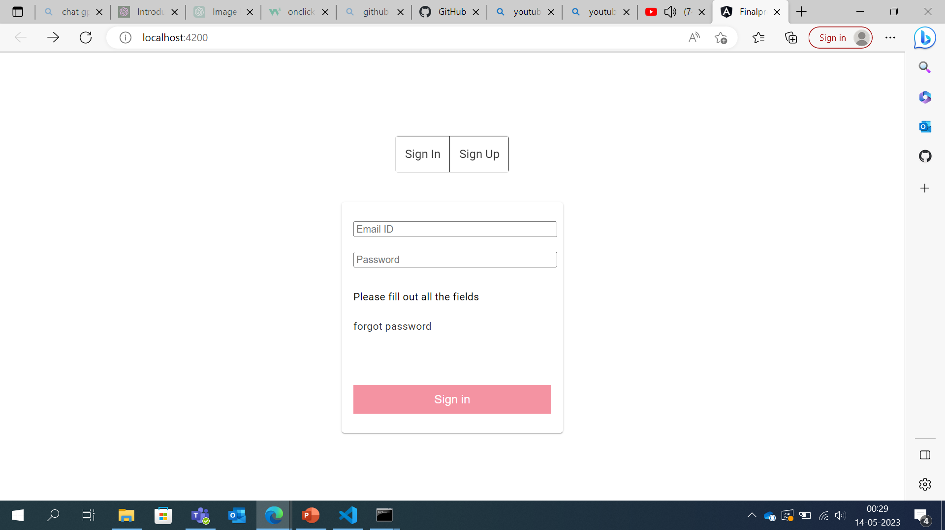
Login page
Take the details :
If user details are provided >> login to user module.
If admin details are provided >> login to admin module.

Slide 5
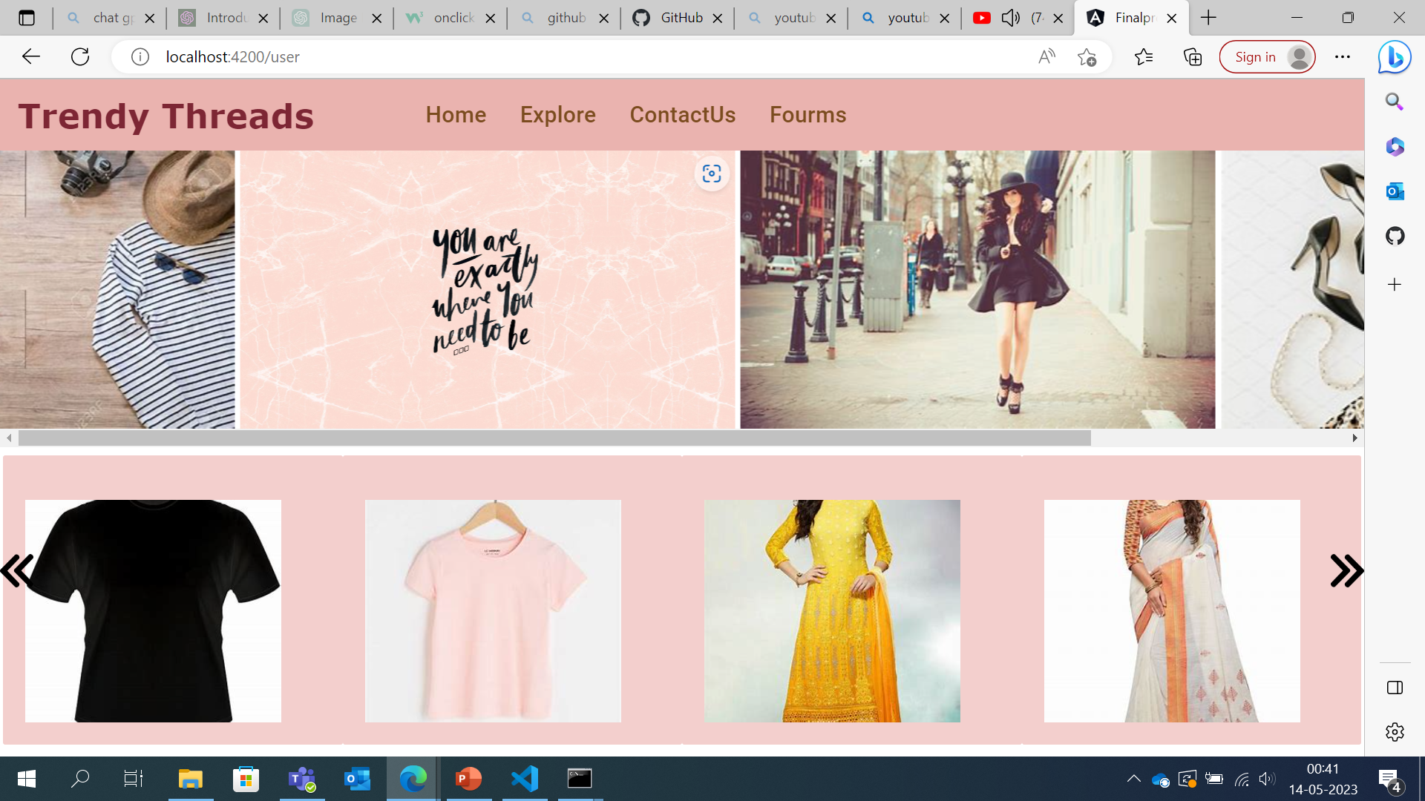
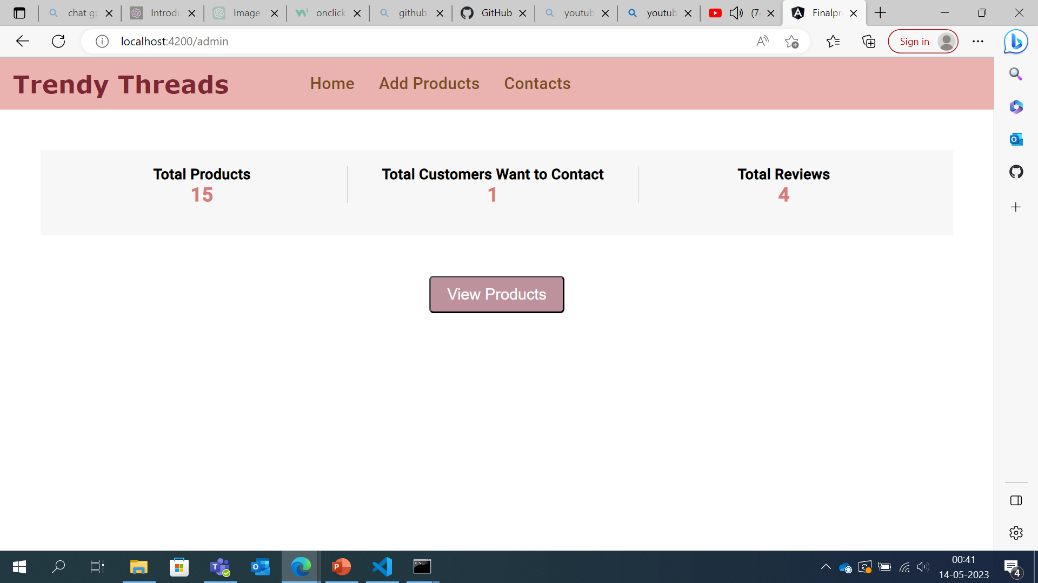
Routing to corresponding modules
User module
Admin module

Slide 6

User side

Slide 7
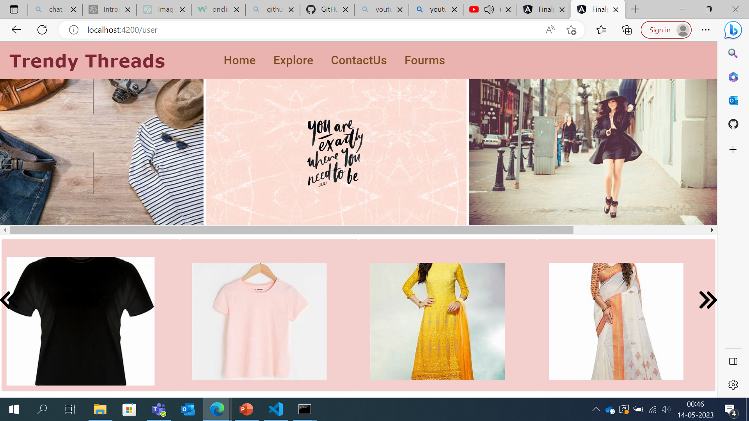
Home component
Latest collections are listed, and a custom directive called Scroll Directive is used to scroll the collections

Slide 8
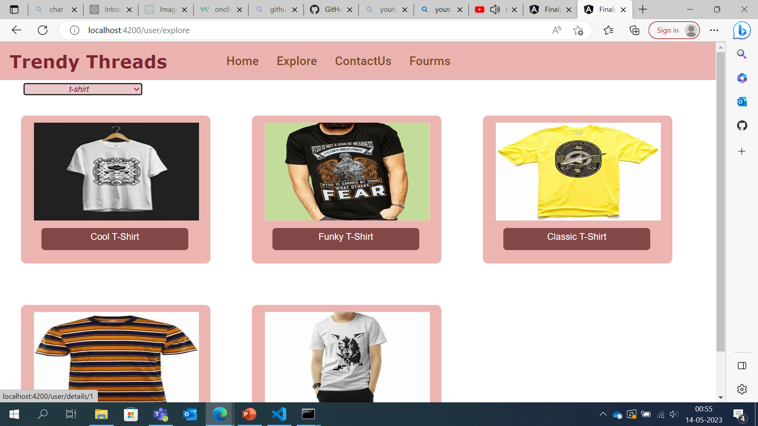
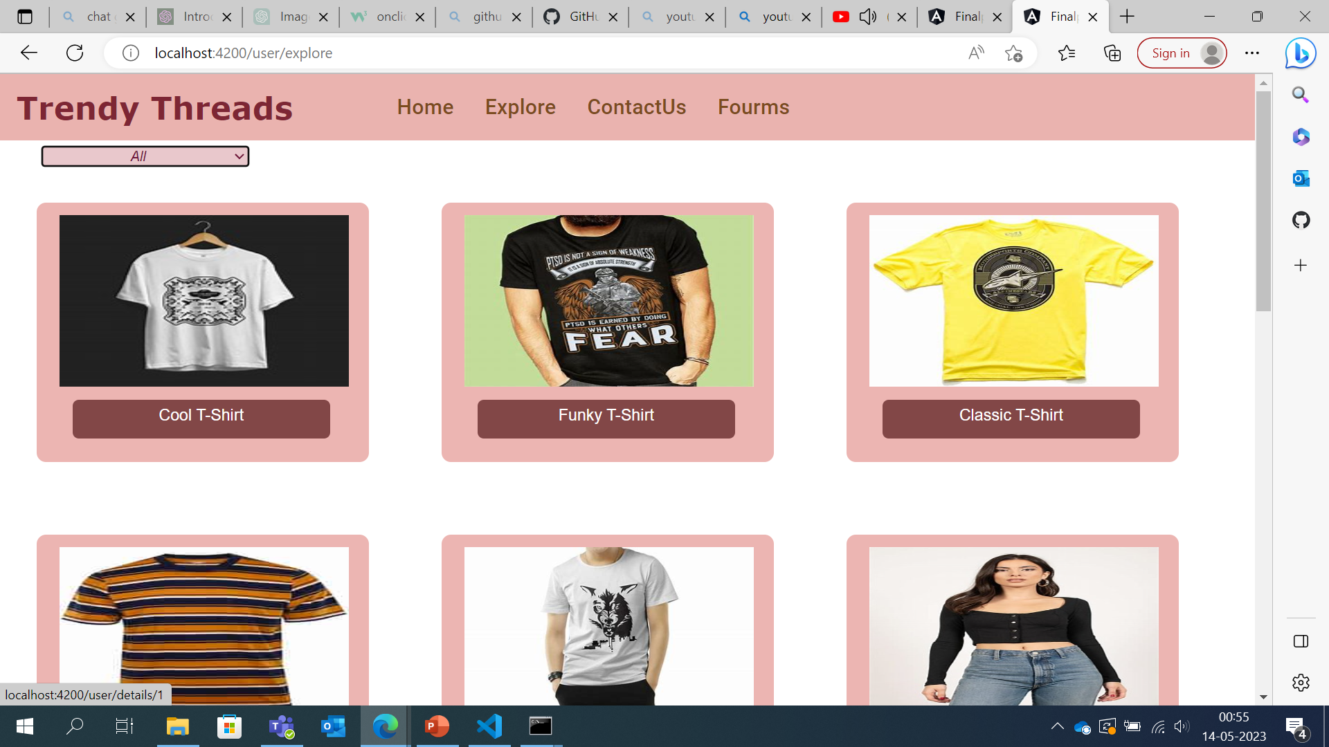
Explore Component
Products are list using product-box component and a filter is used to filter out the products according to the type
After applying filter

Slide 9
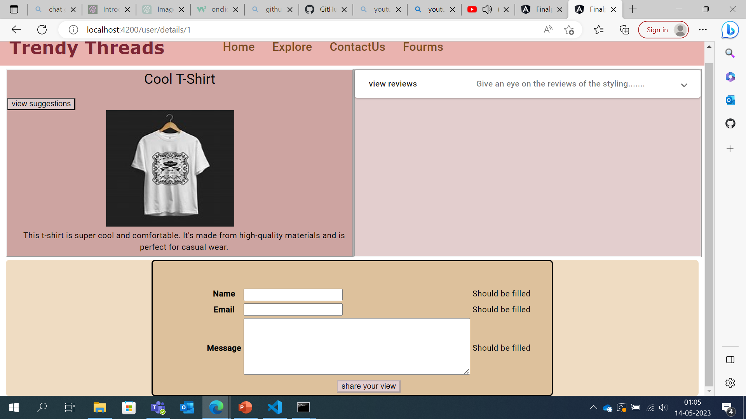
Details Component
Details of product like the name, image, description are listed.

Slide 10
Review Component
Reviews are taken for the products using Model Based form approach.

Slide 11
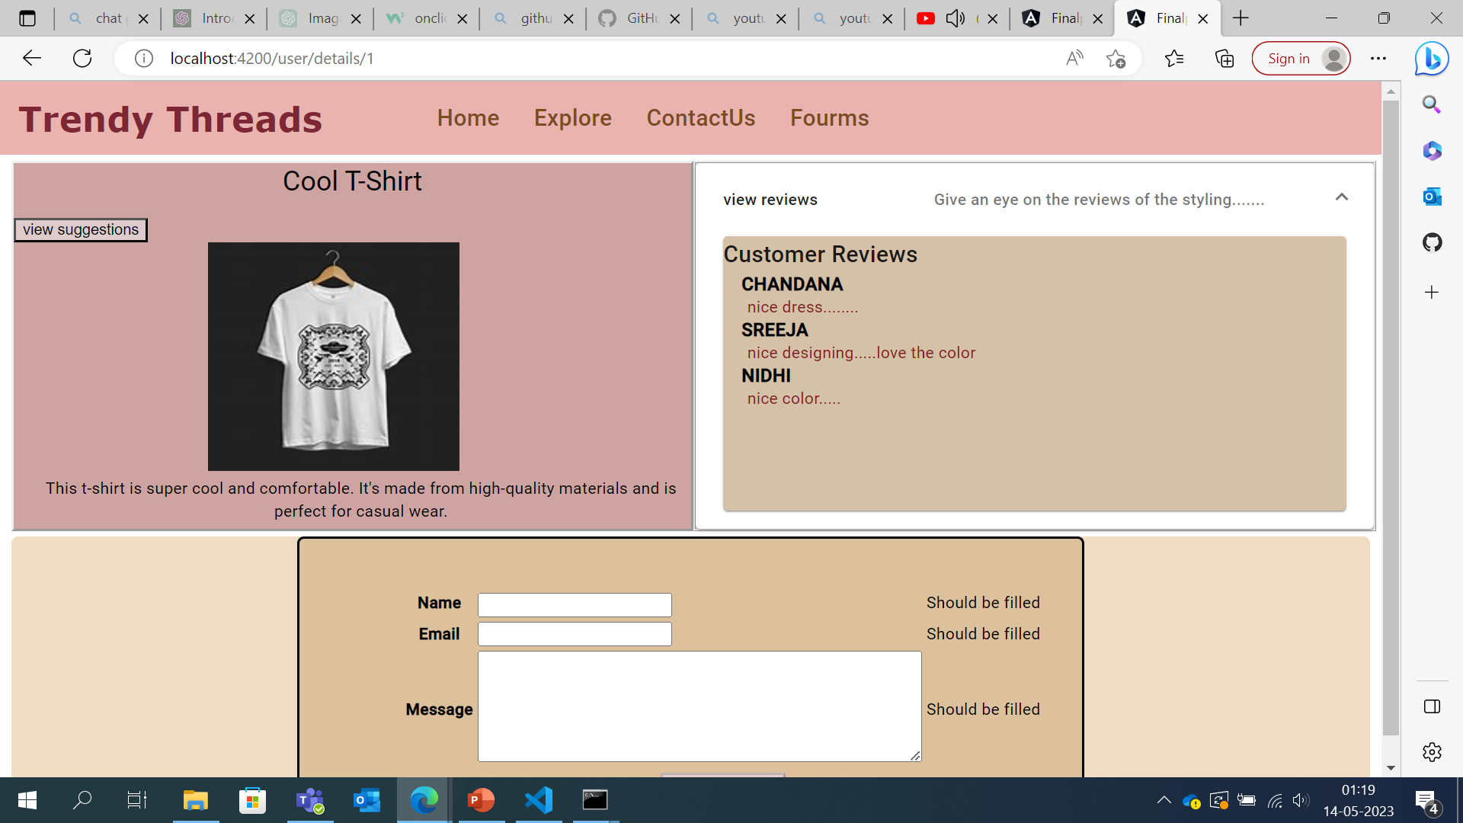
View Review component
The reviews posted for the particular product by the users are viewed next to the product

Slide 12
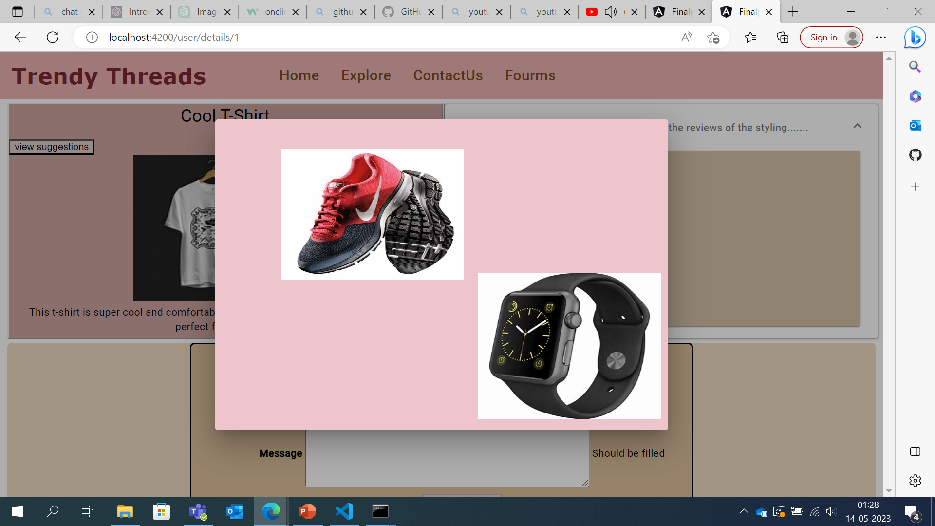
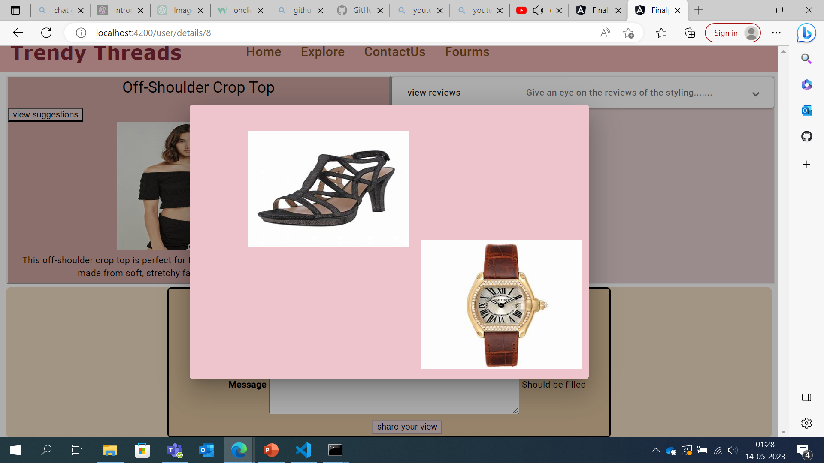
Suggestions Component
The suggested products which can be paired with the current product is viewed here.

Slide 13
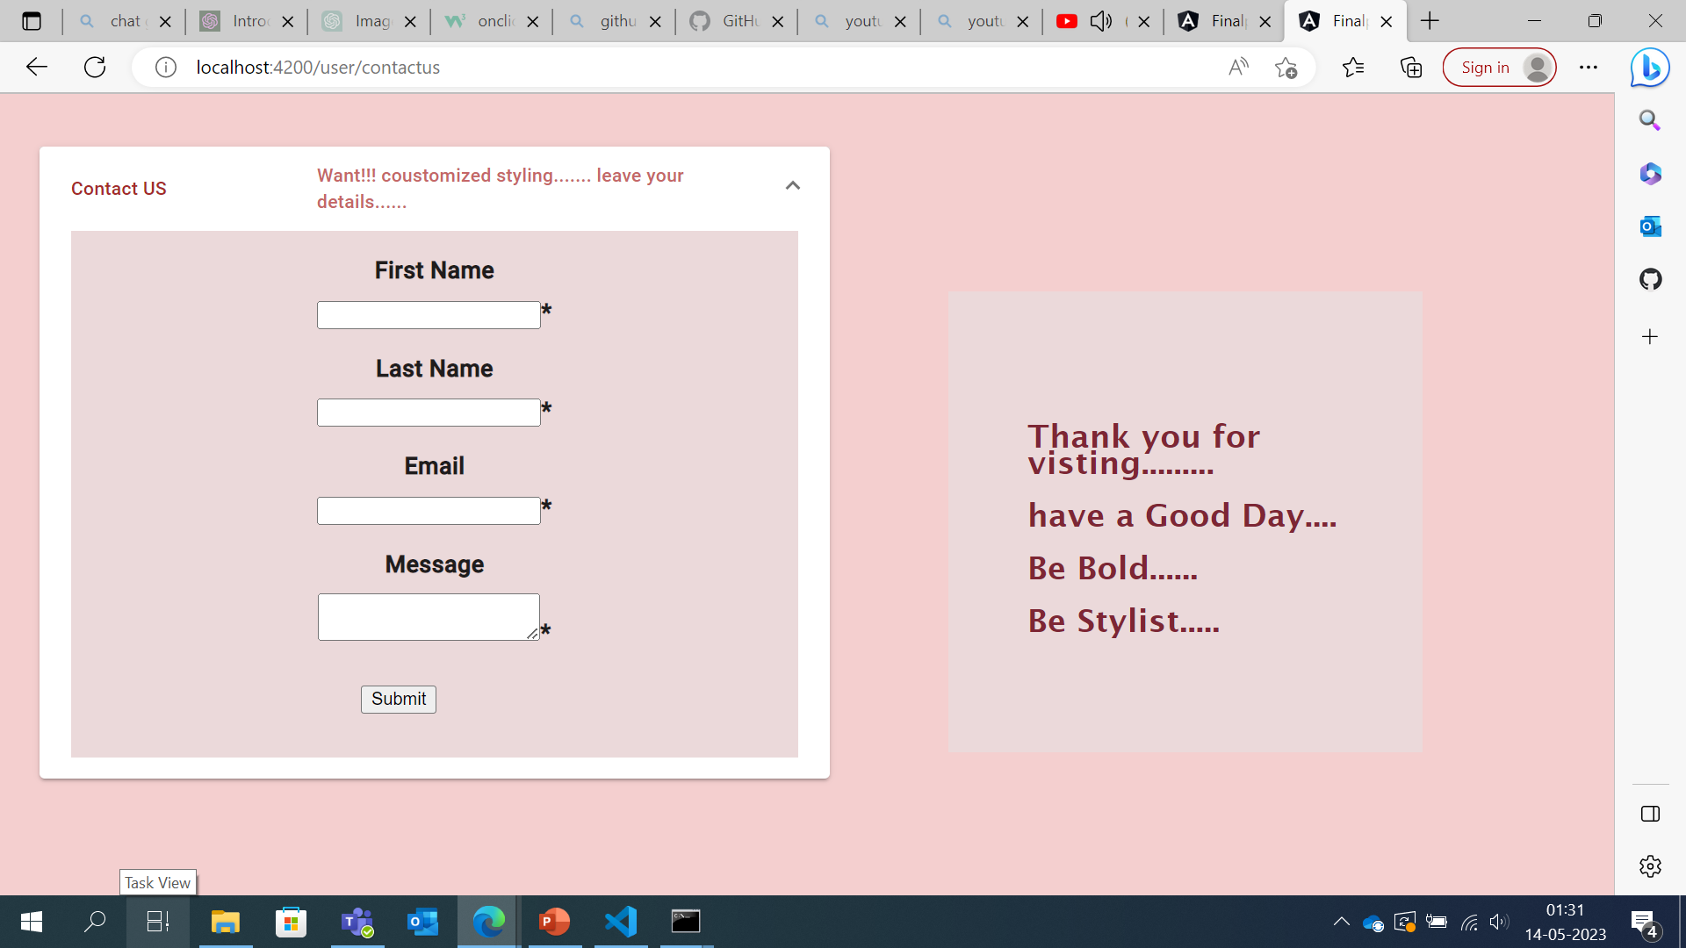
Contact component
The users contacts are collected using the contact component using template based form approach.

Slide 14
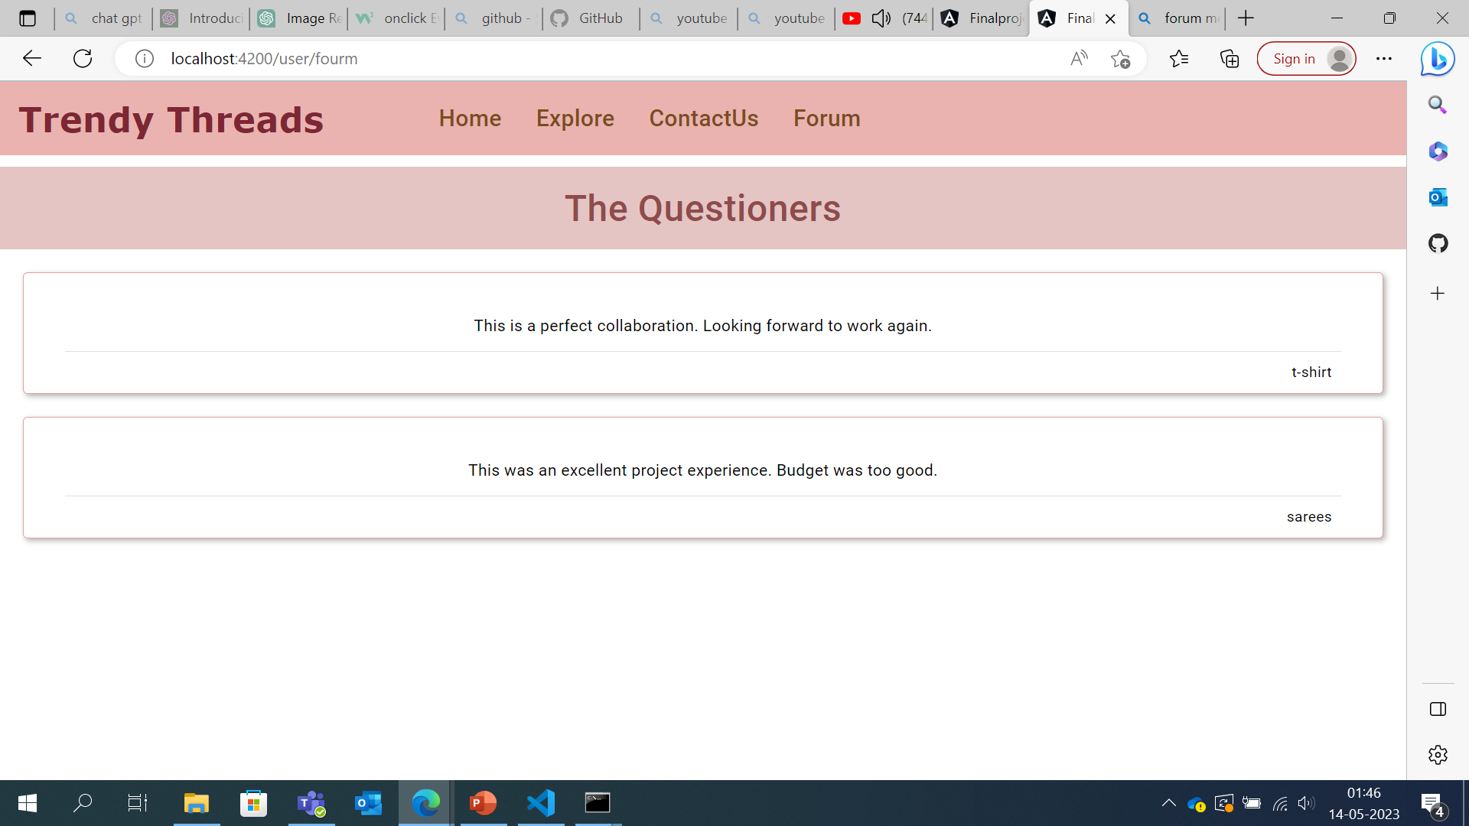
Forum component
The discussions of the users are posted

Slide 15

Admin side

Slide 16
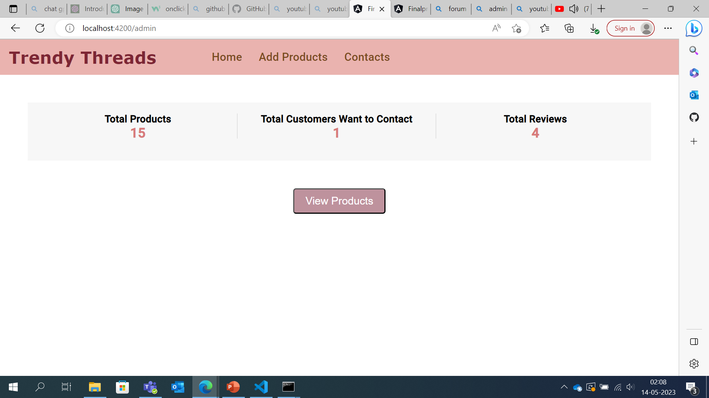
Home Component
The Home component has a Dash Board where it is easy to track the number of products added ,The customers who want to contact and total reviews posted for the admin.

Slide 17
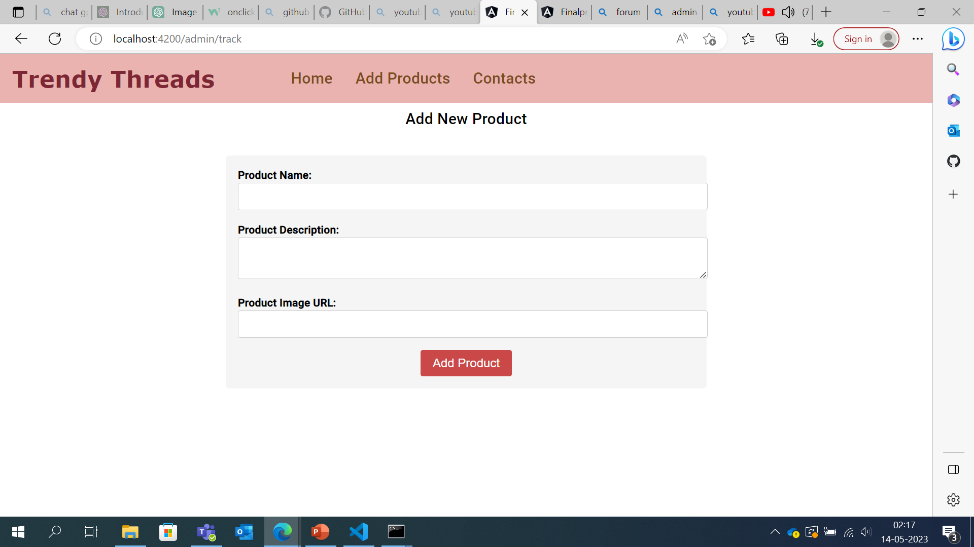
Add Products component
The admin can products in the add products Section.

Slide 18
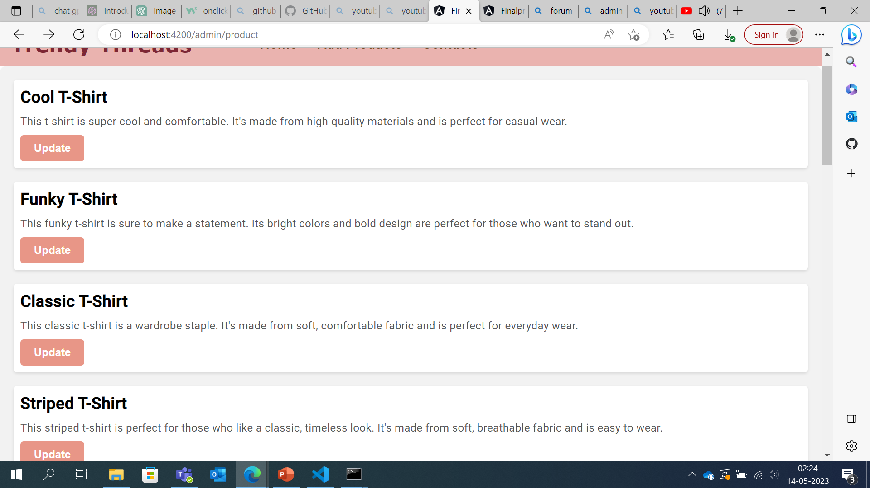
View Products Component
On clicking the view products button the view component is opened where the list of products are listed that has an option of update so that admin can update the products if required.

Slide 19
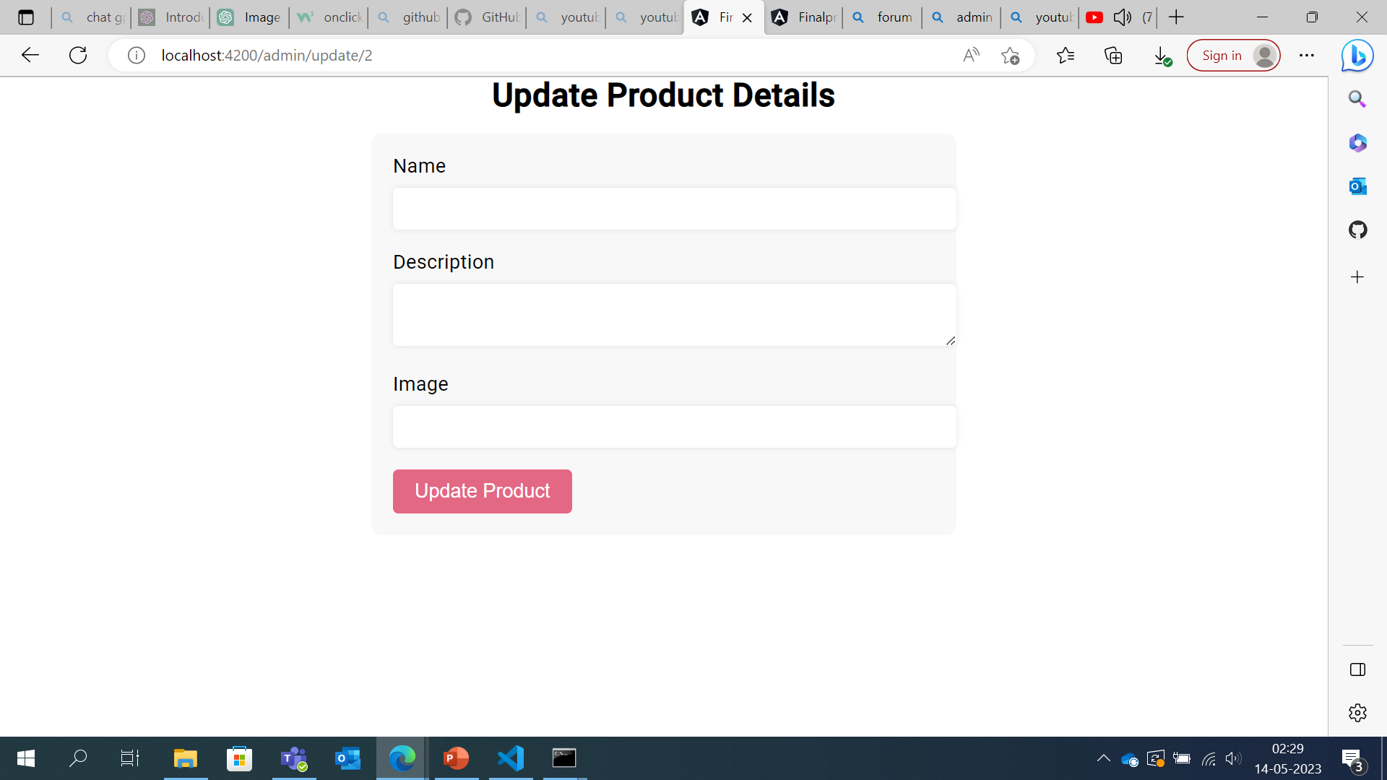
Update component
The admin can update the details of the product here.

Slide 20
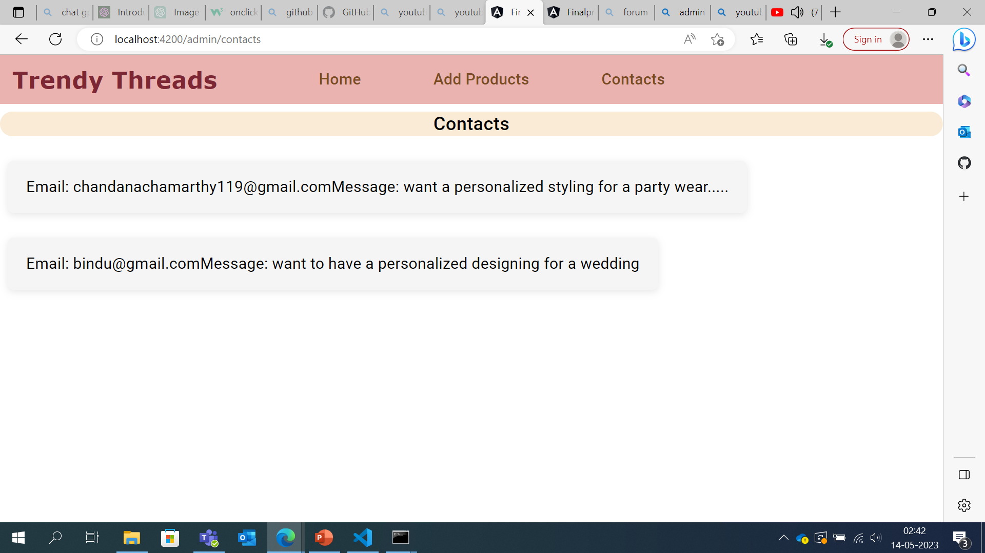
Contact Component
The contact details posted by the user can be viewed by the admin

Slide 21
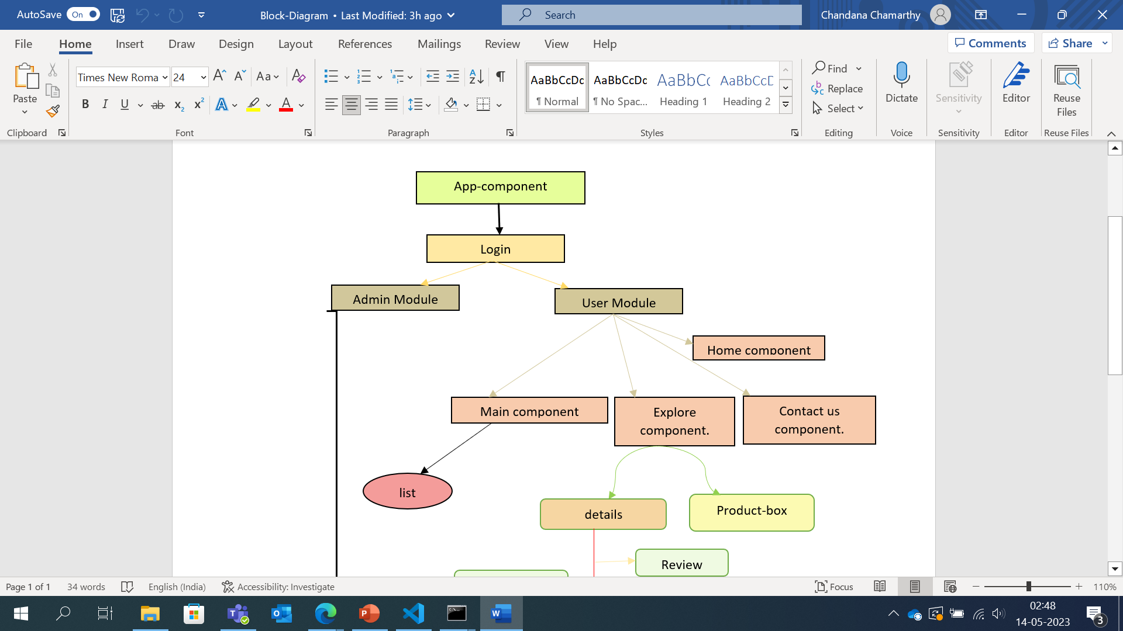
Block Diagram

Slide 22
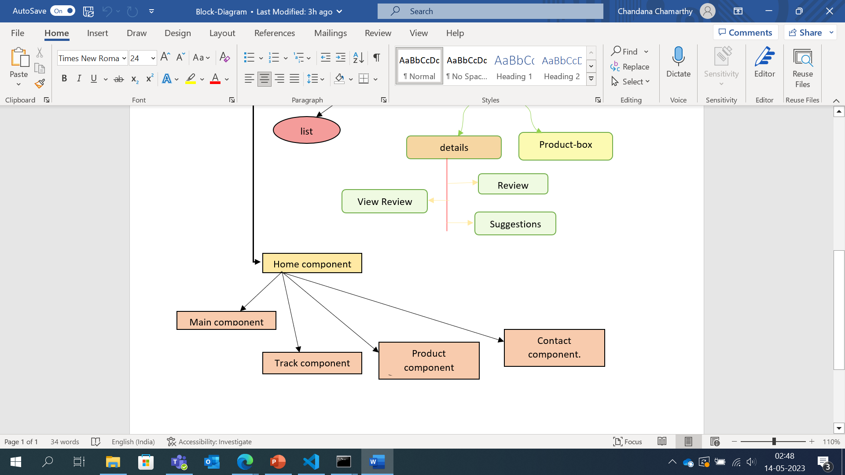

Slide 23


